Slide 1
Cross-Platform with Xamarin Leverage your .NET skills across Windows, Android, and iOS
Ken LeFebvre
Developer Architect

Slide 2

Agenda
What is Xamarin?
Native
Forms
Why Xamarin?
Demonstrations

Slide 3
What is Xamarin?

Slide 4
The Xamarin Platform
Xamarin.iOS
Xamarin.Android
Xamarin.Forms
Xamarin Studio
Xamarin for Visual Studio
Xamarin Insights
Xamarin Test Cloud
Xamarin University

Slide 5
The Xamarin Platform
Xamarin.iOS
Xamarin.Android
Xamarin.Forms
Xamarin Studio
Xamarin for Visual Studio
Xamarin Insights
Xamarin Test Cloud
Xamarin University

Slide 6
The Xamarin Platform
Xamarin.iOS
Xamarin.Android
Xamarin.Forms
Xamarin Studio
Xamarin for Visual Studio
Xamarin Insights
Xamarin Test Cloud
Xamarin University

Slide 7
The Xamarin Platform
Xamarin.iOS
Xamarin.Android
Xamarin.Forms
Xamarin Studio
Xamarin for Visual Studio
Xamarin Insights
Xamarin Test Cloud
Xamarin University

Slide 8
The Xamarin Platform
Xamarin.iOS
Xamarin.Android
Xamarin.Forms
Xamarin Studio
Xamarin for Visual Studio
Xamarin Insights
Xamarin Test Cloud
Xamarin University

Slide 9
The Xamarin Platform
Xamarin.iOS
Xamarin.Android
Xamarin.Forms
Xamarin Studio
Xamarin for Visual Studio
Xamarin Insights
Xamarin Test Cloud
Xamarin University

Slide 10
The Xamarin Platform
Xamarin.iOS
Xamarin.Android
Xamarin.Forms
Xamarin Studio
Xamarin for Visual Studio
Xamarin Insights
Xamarin Test Cloud
Xamarin University

Slide 11
Why Xamarin?

Slide 12
Xamarin vs. Alternatives
Native
Mobile Web
Apache Cordova
Telerik Platform

Slide 13
Xamarin vs. Alternatives
Android Studio: Java
XCode: Objective-C/Swift
Visual Studio: C#/XAML
Native
Mobile Web
Apache Cordova
Telerik Platform

Slide 14
Xamarin vs. Alternatives
Complete control
Highest learning curve
Hardware control
No sharing of code
Offline execution
Native
Mobile Web
Apache Cordova
Telerik Platform

Slide 15
Xamarin vs. Alternatives
Visual Studio: ASP.NET
C#, VB.NET, HTML, Javascript
Native
Mobile Web
Apache Cordova
Telerik Platform

Slide 16
Xamarin vs. Alternatives
Lowest learning curve
Minimal device control
All code on server
No deployment
No offline execution
Native
Mobile Web
Apache Cordova
Telerik Platform

Slide 17
Xamarin vs. Alternatives
Text Editor
Visual Studio 2015
HTML, Javascript
Native
Mobile Web
Apache Cordova
Telerik Platform

Slide 18
Xamarin vs. Alternatives
Low learning curve
Moderate device control
Highly shared code
Offline execution
Native
Mobile Web
Apache Cordova
Telerik Platform

Slide 19
Xamarin vs. Alternatives
Browser-based IDE
HTML, Javascript
Native
Mobile Web
Apache Cordova
Telerik Platform

Slide 20
Xamarin vs. Alternatives
Low learning curve
Less mature
Moderate device control
Highly shared code
Offline execution
Native
Mobile Web
Apache Cordova
Telerik Platform

Slide 21
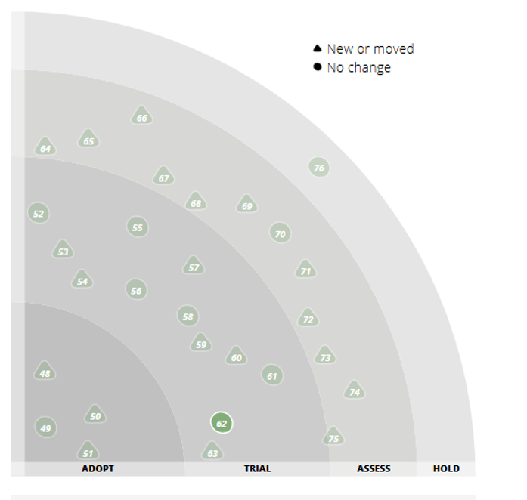
ThoughtWorks Radar
We are excited by the progress made by Xamarin in offering a solid choice for building cross-platform mobile apps.
It supports C# and F# as the primary languages with bindings to platform specific SDKs and the Mono runtime environment that works across iOS, Android and Windows Phone. Applications are compiled to native code giving apps a more native look and feel. When using this toolset, it is imperative that the platform specific UI tier be separated from the rest of the tiers to ensure code reuse across different platforms. The recent open-sourcing of the .NET platform should be beneficial for Xamarin both in allowing access to a broader set of .NET tooling and also making development easier on other operating systems.

Slide 22

Gartner's Magic Quadrant

Slide 23
Gartner's Magic Quadrant

Slide 24
Strengths
Cautions
Xamarin addresses an untapped market need: C# developers who want to apply their skills to mobile, while delivering fully native user experiences and application performance.
Xamarin provides its own cross-platform mobile development tool, Xamarin Studio, coupled with an extensive library of Xamarin and third-party components, visual design tools for iOS and Android, and integration with Visual Studio.
Xamarin has built a strong partner presence, both in terms of strategic partnerships, such as with Microsoft and SAP, as well as a significant pool of implementation and channel partners.
Xamarin has lagged behind a number of larger players when it comes to supporting the mobile application life cycle, but it is rapidly filling in gaps and benefiting from the Microsoft ALM tools and ecosystem.
Xamarin has historically focused on front-end development. Mobility projects that require back-end integration, new back-end logic or synchronization for offline use will need to augment Xamarin with technologies from Microsoft or third parties.
The company is relatively small, competing against well-established mobile vendors with large ecosystems as well as other innovative small companies.

Slide 25


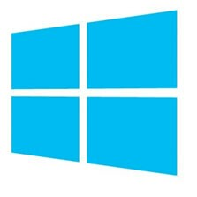
Xamarin vs. Xamarin
Xamarin.iOS
Xamarin.Android
Xamarin.Forms

Slide 26
Demo
Walkthrough of a Xamarin Development Environment
Notes:
Template: 201-2-vms-loadbalancer-lbrules
https://github.com/Azure/azure-quickstart-templates/tree/master/201-2-vms-loadbalancer-lbrules

Slide 27
Demo
Port Java to C# with Xamarin.Android
Notes:
Template: 201-2-vms-loadbalancer-lbrules
https://github.com/Azure/azure-quickstart-templates/tree/master/201-2-vms-loadbalancer-lbrules

Slide 28
Demo
Share Common Codebase Across Android, iOS, and Windows Phone
Notes:
Template: 201-2-vms-loadbalancer-lbrules
https://github.com/Azure/azure-quickstart-templates/tree/master/201-2-vms-loadbalancer-lbrules

Slide 29
Issues
Emulators are fragile
Always rebuild all
Bad references cause mysterious errors
Get to know Nunit-Lite

Slide 30
Thank You!
Ken LeFebvre
@kenlefeb | linkedin.com/kenlefeb
klefebvre@macropoint.com | www.macropoint.com

Slide 31
July .NET SIG 7/14/2015 Rich Deken Bennett Adelson
Microsoft Stream Analytics

